Slide 1
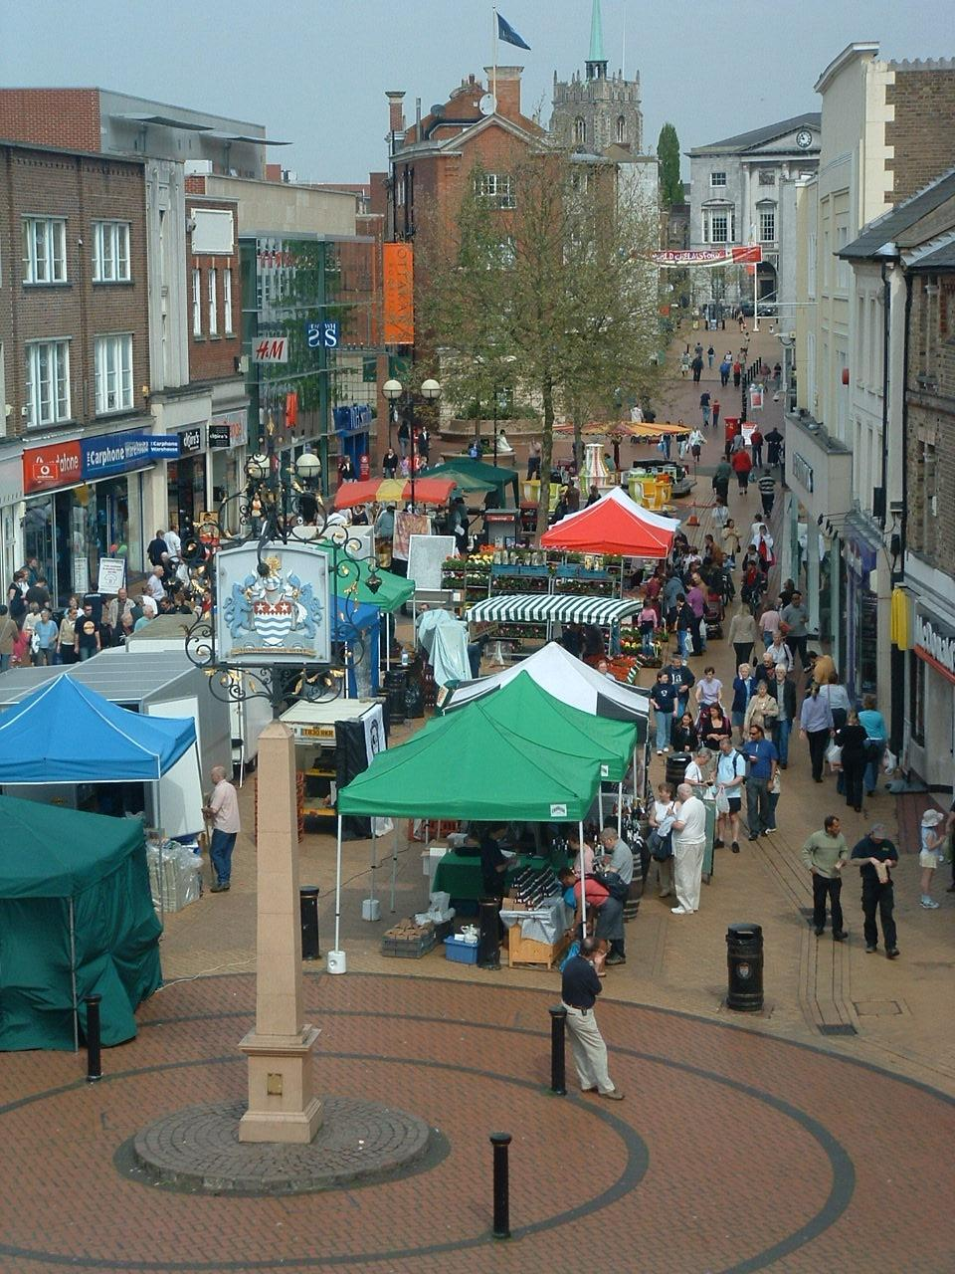
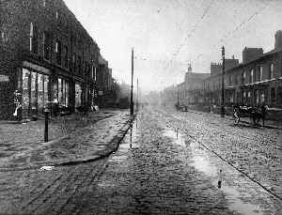
Changes in the CBD

Slide 2
Today’s Objectives
What CBD’s used to be like and why shops located there.
The problems for British town centres
Why out of town shopping centres grew and their problems.
How have town centres fought back….

Slide 3
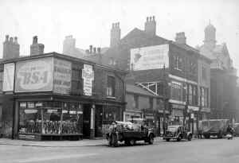
Why have shops traditionally located in town centres?

Slide 4
1)They had most people living and working there so more potential shoppers – threshold population…
2) Comparison good shops benefit from being close to each other.
3) Town centres traditionally the most accessible place
4) Fairly small scale businesses

Slide 5
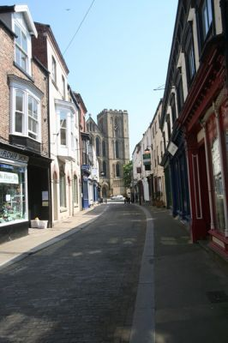
The problems for British town centres

Slide 6
Task
Read page 58 from Waugh and note some of the problems faced by traditional town CBD’s.

Slide 7
Why out of town shopping centres grew and their problems.

Slide 8
Cheap land
More space for building and car parking
Better transport opportunity
Most population in the suburb, so it makes sense for shops to be there….
Backed by planners and had financial backing

Slide 9
Result
Retail parks……
Regional Shopping centres

Slide 10
Case study
MERRY HILL Vs DUDLY HIGH STREET

Slide 11
Benefits of out of town
Cheaper
Safe
Employment (4000)
25 million shoppers
Easier to shop – shops are close together
Wheelchair access
High street was in decline anyway

Slide 12
Shelter from weather
Lots of entertainment

Slide 13
Disadvantages of out of town
Taken all of Dudley High Street trade (loss of 70%).
Shops close down.
Smaller businesses can’t move and so decline
Not all have cars and therefore find it difficult to get there.

Slide 14
Any shops left in the high street sell cheap and poor quality goods.

Slide 15
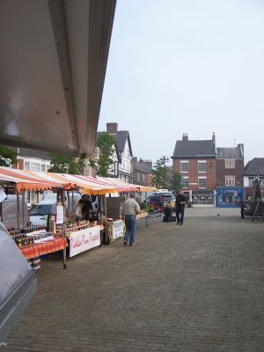
How have town centres fought back….

Slide 16
Build in town shopping centres. Eg Queensgate Centre, Peterborough
Pedestrianised zones
CCTV for safer environment
More relaxing atmosphere
Introducing new specialist shops and services.
Farmers markets, cafes etc.

Slide 17
This powerpoint was kindly donated to www.worldofteaching.com
http://www.worldofteaching.com is home to over a thousand powerpoints submitted by teachers. This is a completely free site and requires no registration. Please visit and I hope it will help in your teaching.

